Slide 1

Centralized Medical Record System using RFID and Blockchain
Sanjay Suresh 20BPS1024
Athul Ravi 20BPS1029
Ajith Suresh 20BPS1064
Pranav Viswanathan 20BPS1106

Slide 2

Contents
List of modules in project + their function
Flow diagrams and architecture for each module
Algorithm + Process flow

Slide 3

Modules of Project
There are five distinct modules that this project makes use of –
RFID tag – scanner, for accessing immediate medical information in situations of medical emergency
Data collection, to collect medical information from first time users
Blockchain, to store complete medical information in a decentralized manner
Autofill, to make use of data stored in the blockchain to fill medical forms
Authentication, to differentiate first responders from medical practitioners, individual and those working at medical establishments

Slide 4
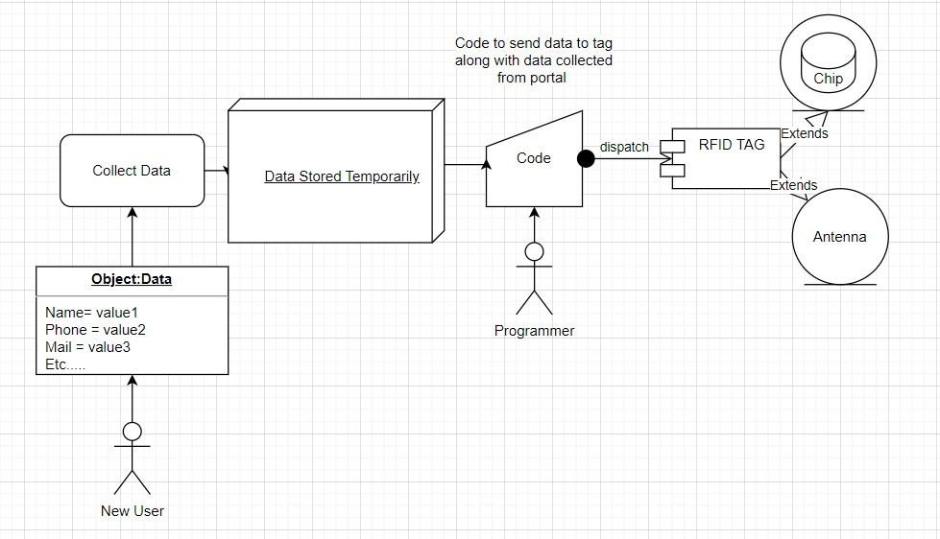
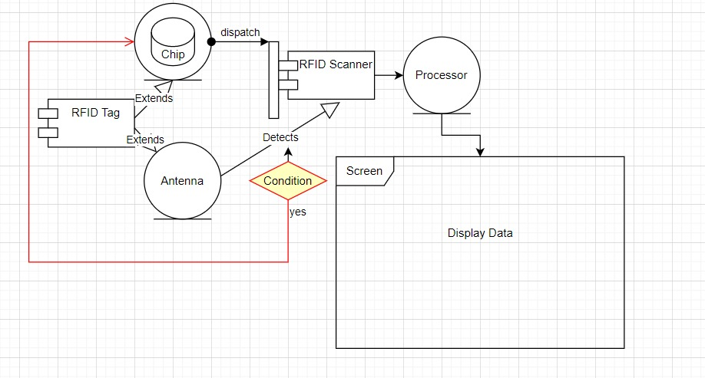
Module-wise UML Diagrams
RFID tag – scanner
RFID tag
RFID scanner

Slide 5
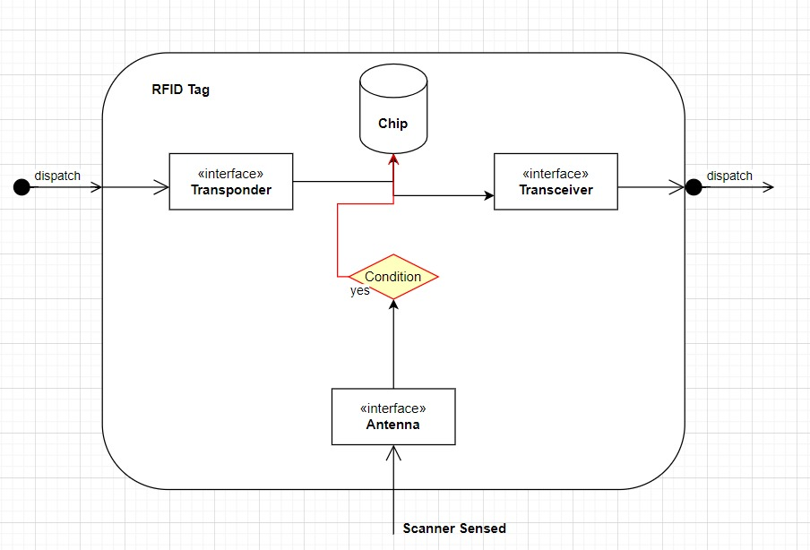
Module-wise UML Diagrams
RFID tag (internally)

Slide 6
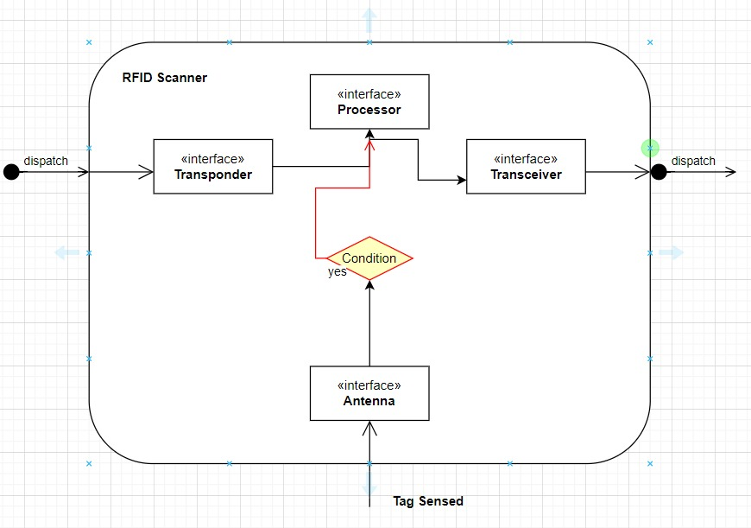
Module-wise UML Diagrams
RFID scanner (internally)

Slide 7
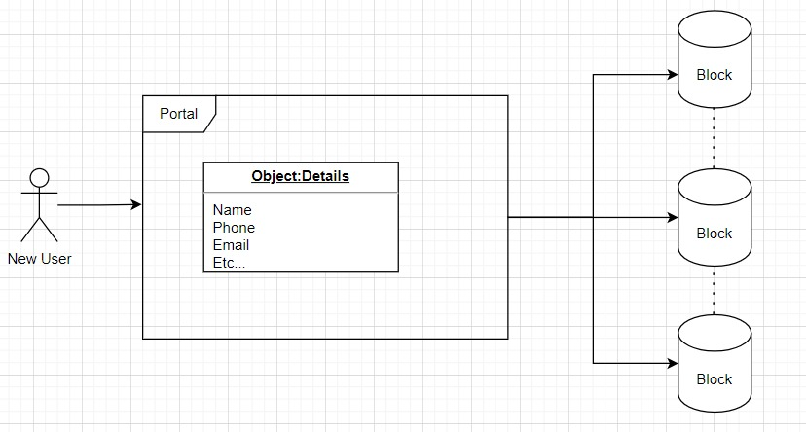
Module-wise UML Diagrams
Data collection

Slide 8
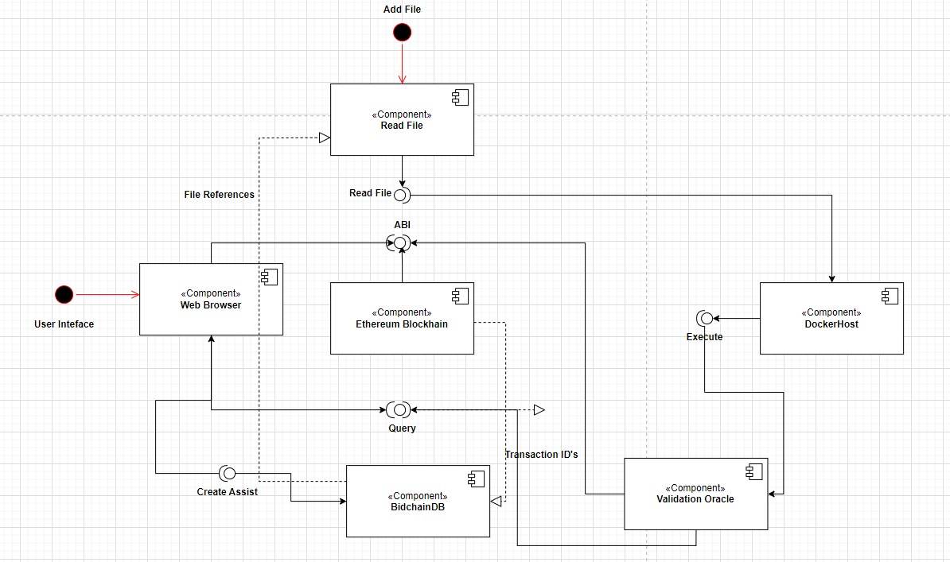
Module-wise UML Diagrams
Blockchain

Slide 9
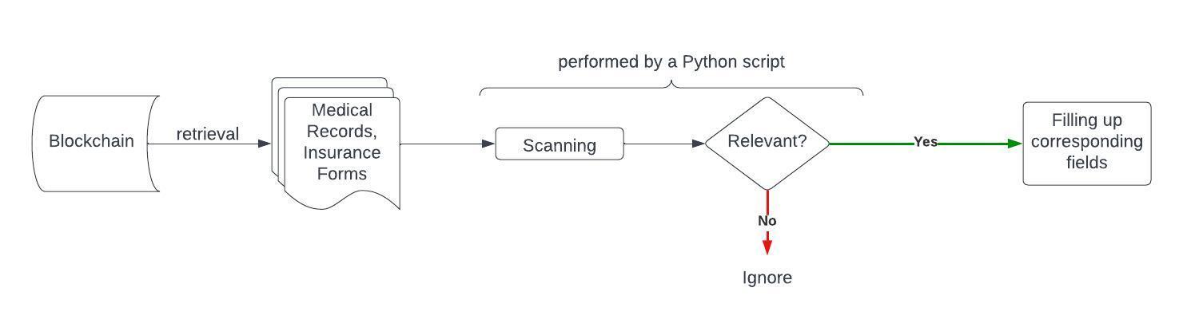
Module-wise UML Diagrams
Autofill

Slide 10
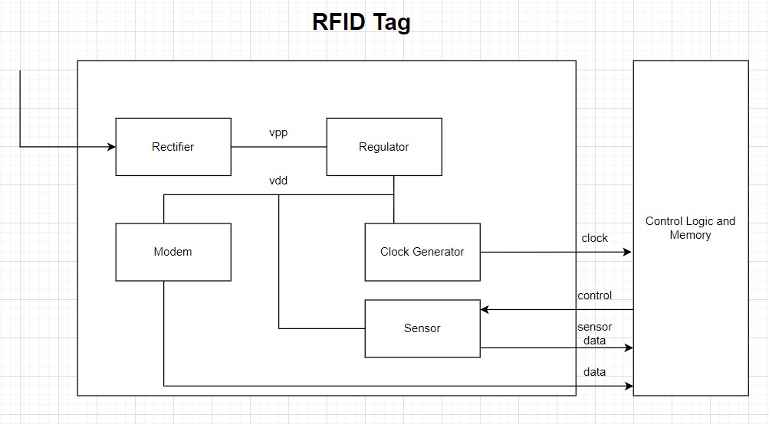
Component Architecture
RFID tag

Slide 11
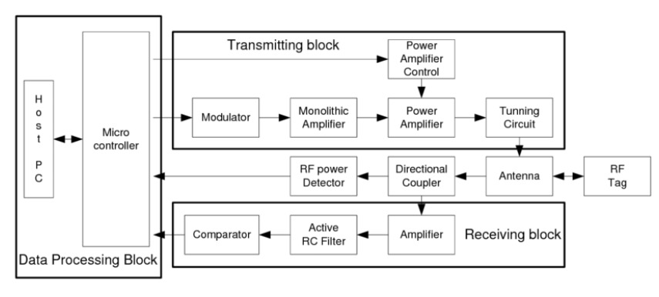
Component Architecture
RFID scanner

Slide 12
Algorithms & Process Flow Representations

Slide 13
Blockchain Implementation
// define blockchain class
class Blockchain {
constructor() {
this.chain = [];
this.current_transactions = [];
}
// create new block
createNewBlock(proof, previousHash = null) {
// create a new block
const newBlock = {
index: this.chain.length + 1,
timestamp: Date.now(),
transactions: this.current_transactions,
proof: proof,
previousHash: previousHash
};
// set current transactions to empty array
this.current_transactions = [];
// add the new block to the chain
this.chain.push(newBlock);
return newBlock;
}
// create a new transaction
createTransaction(sender, recipient, data) {
// create a new transaction
const newTransaction = {
sender: sender,
recipient: recipient,
data: data
};
// add the transaction to the current transactions
this.current_transactions.push(newTransaction);
return this.chain.length;
}
// create a file storage block
createFileStorageBlock() {
const newBlock = {
index: this.chain.length + 1,
timestamp: Date.now(),
transactions: this.current_transactions,
files: {},
proof: proof,
previousHash: previousHash
};
// set current transactions to empty array
this.current_transactions = [];
// add the new block to the chain
this.chain.push(newBlock);
return newBlock;
}
// add file to the file storage block
addFileToStorageBlock(fileName, fileData) {
// get the last block
const lastBlock = this.chain[this.chain.length - 1];
// add the file to the files object
lastBlock.files[fileName] = fileData;
return true;
}
}
module.exports = Blockchain;

Slide 14
Blockchain Implementation
// create new block
createNewBlock(proof, previousHash = null) {
// create a new block
const newBlock = {
index: this.chain.length + 1,
timestamp: Date.now(),
transactions: this.current_transactions,
proof: proof,
previousHash: previousHash
};
// set current transactions to empty array
this.current_transactions = [];
// add the new block to the chain
this.chain.push(newBlock);
return newBlock;
}
// create a new transaction
createTransaction(sender, recipient, data) {
// create a new transaction
const newTransaction = {
sender: sender,
recipient: recipient,
data: data
};
// add the transaction to the current transactions
this.current_transactions.push(newTransaction);
return this.chain.length;
}
// create a medical data storage block
createMedicalDataStorageBlock() {
const newBlock = {
index: this.chain.length + 1,
timestamp: Date.now(),
transactions: this.current_transactions,
medicalData: {},
proof: proof,
previousHash: previousHash
};
// set current transactions to empty array
this.current_transactions = [];
// add the new block to the chain
this.chain.push(newBlock);
return newBlock;
}
// add medical data to the medical data storage block
addMedicalDataToStorageBlock(dataName, data) {
// get the last block
const lastBlock = this.chain[this.chain.length - 1];
// add the file to the files object
lastBlock.medicalData[dataName] = data;
return true;
}
// get medical data from the medical data storage block
getMedical

Slide 15
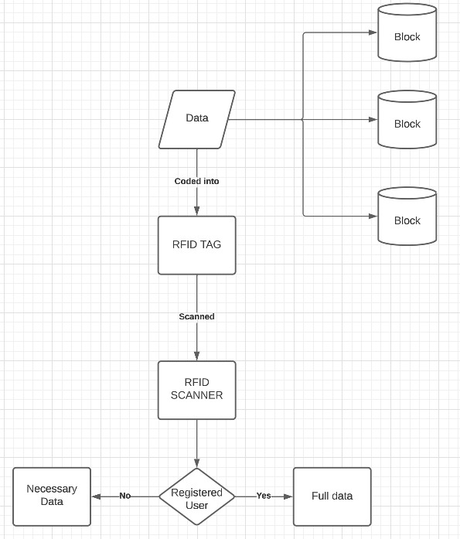
Overall Process Flow (excl. Autofill)

Slide 16
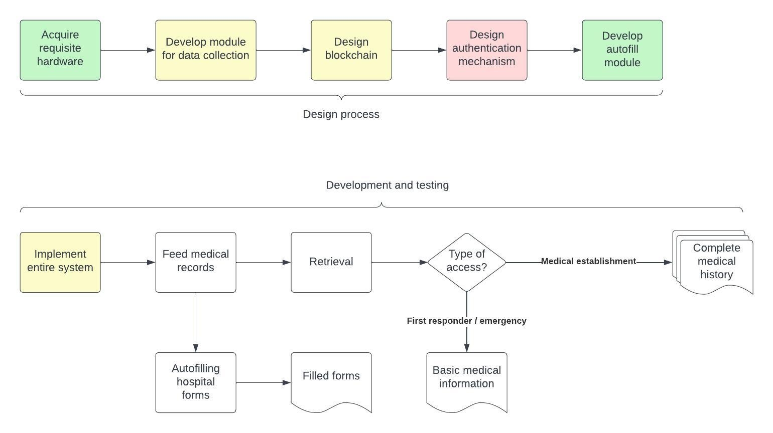
Project Phases

Slide 17

THANK YOU

